Slide 1
Building Android apps – Week 5
2843-201710_MCS4993_M:Topics in MA/CS
2843-201710_MCS5993_M:Topics in Computer Science

Slide 2
Agenda
Chapter 8 HFAD – Nested Fragments
Chapter 9 HFAD – Action Bars
Assignment – Use case titles for class project (due by email 9/22)

Slide 3
Bullet Points
Fragments can contain other fragments.
If you’re nesting a fragment in another fragment, you need to add the nested fragment programmatically in Java code.
When you perform transactions on a nested fragment, use getChildFragmentManager() to create the transaction.
If you use the android:onClick attribute in a fragment, Android will look for a method of that name in the fragment’s parent activity.
Instead of using the android:onClick attribute in a fragment, make the fragment implement the View.OnClickListener interface and implement its onClick() method..

Slide 4
Bullet Points
When the device configuration changes, the activity and its fragments get destroyed. When the activity is re-created, it replays its fragment transactions in the onCreate() method’s call to setContentView().
The fragment’s onCreateView() method runs after the activity has replayed its fragment transactions.

Slide 5
Notes:
In Chapter 7, you saw how to create fragments, how to include them in activities, and how to connect them together. To do this, we created a list fragment displaying a list of workouts, and a fragment displaying details of a single workout.It’s not just activities that can contain fragments—fragments can be nested inside other fragments. So that you can see this in action, we’re going to add a stopwatch fragment to our workout detail fragment.

Slide 6
Notes:
We’re going to add a new stopwatch fragment called StopwatchFragment.java that uses a layout called fragment_stopwatch.xml. We’re going to base the fragment on the stopwatch activity we created back in Chapter 4.
We already know that activities and fragments behave in similar ways, but we also know that a fragment is a distinct type of object—a fragment is not a subclass of activity. Is there some way we could rewrite that activity code so that it works like a fragment?

Slide 7
Lifecycle Method | Activity? | Fragment?
onAttach() |  | X
onCreate() | X | X
onCreateView() |  | X
onActivityCreated() |  | X
onStart() | X | X
onPause() | X | X
onResume() | X | X
onStop() | X | X
onDestroyView() |  | X
onRestart() | X
onDestroy() | X | X
onDetach() |  | X
Notes:
If we look at the lifecycles of fragments and activities, we’ll see that they’re very similar
Fragment lifecycle methods are almost the same as activity lifecycle methods, but there’s one major difference: activity lifecycle methods are protected and fragment lifecycle methods are public. And we’ve already seen that the way fragments create a layout from a layout resource file is different.
Also, in a fragment, we can’t call methods like findViewById() directly. Instead, we need to find a reference to a View object, and then call view.findViewById().

Slide 8
Notes:
We’re going to take the code from StopwatchActivity in Chapter 4 and convert it to StopwatchFragment.

Slide 9
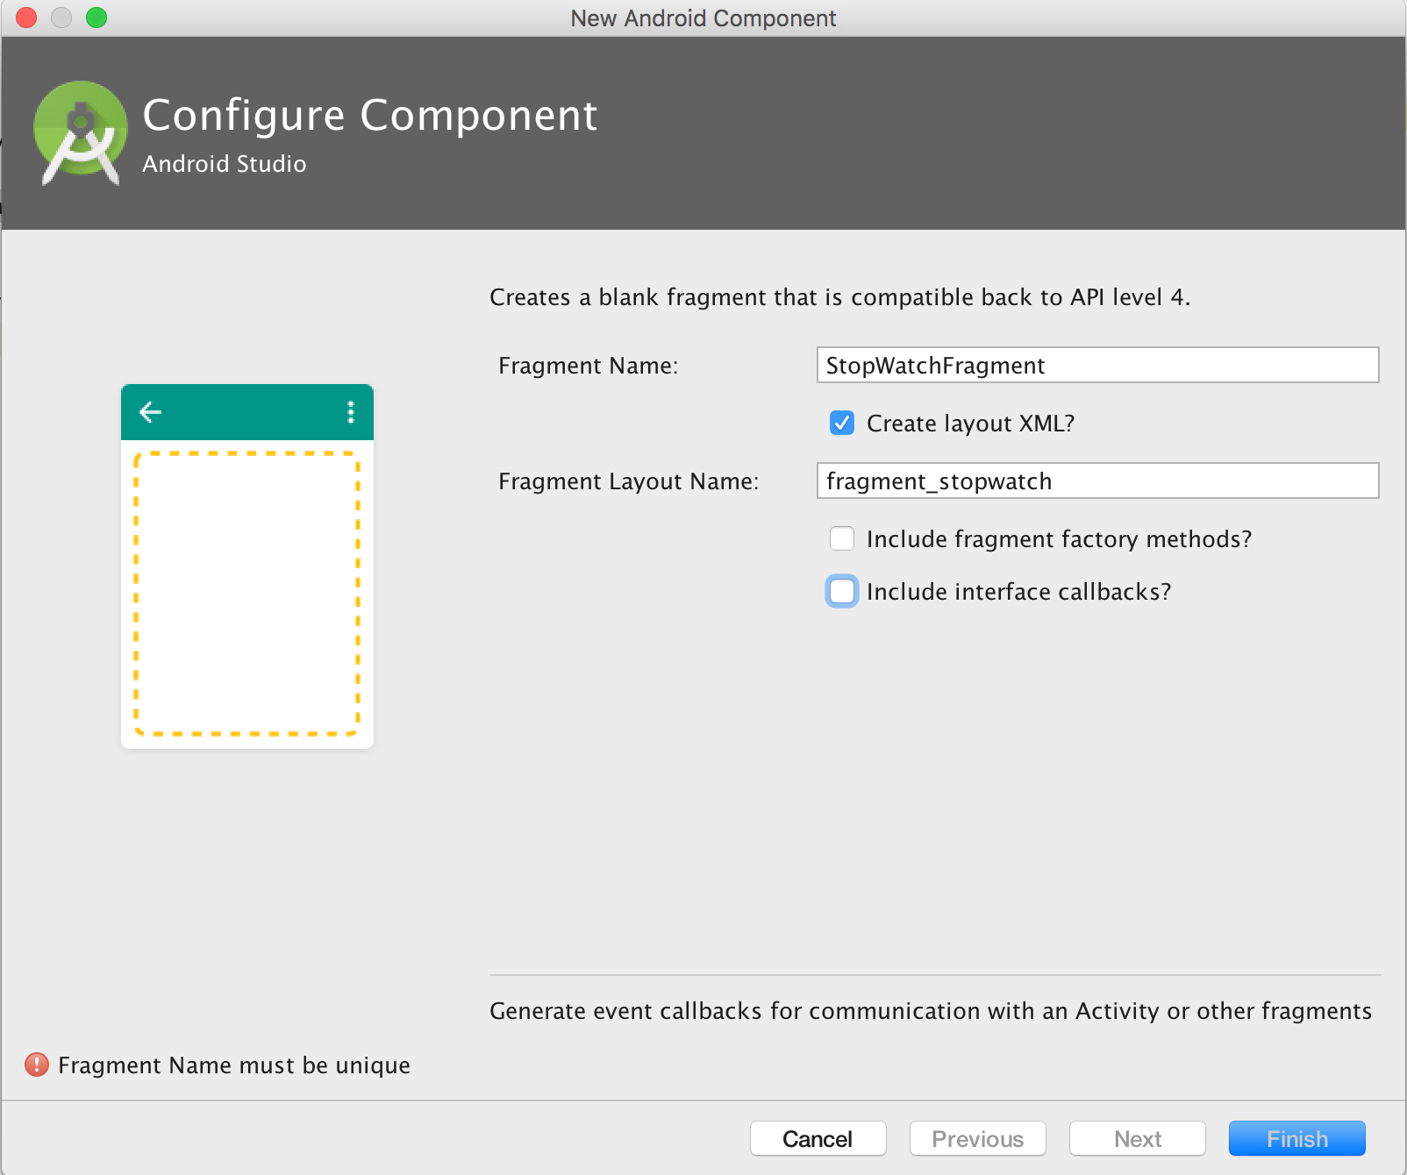
Notes:
We’ll add StopwatchFragment to our Workout project so that we can use it in our app. You do this in the same way you did in Chapter 7. Go to File→New...→Fragment→Fragment (Blank). Give the fragment a name of “StopwatchFragment”, a layout name of “fragment_stopwatch”, and untick the options for including fragment factory methods and interface callbacks.

Slide 10
Notes:
Replace the fragment code Android Studio gives you with the following code

Slide 11
Notes:
That’s all the Java code we need for our StopwatchFragment. The next thing we need to do is say what the fragment should look like by updating the layout code Android Studio gave us.

Slide 12
Notes:
We’ll use the same layout for StopwatchFragment as we used in our original Stopwatch app. Replace the contents of fragment_stopwatch.xml with the code below:

Slide 13
Notes:
The XML code in fragment_stopwatch.xml uses string values for the text on the Start, Stop, and Reset buttons. We need to add these to strings. xml:

Slide 14
Notes:
The Stopwatch fragment looks just like it did when it was an activity. The difference is that we can now use it in other activities and fragments. The next thing we need to do is display it when we show the user details of the workout they choose.

Slide 15
Notes:
We’re going to add the StopwatchFragment inside the WorkoutDetailFragment. The user interface of MainActivity on a tablet will link together like this:
There are two ways of adding a fragment, using a layout file and writing Java code. If you add a fragment to another fragment’s layout the result can be flaky, so we’re going to add the StopwatchFragment to the WorkoutDetailFragment using Java code. That means we’re going to do it in almost the same way that we added the WorkoutDetailFragment to the activity.
If you nest fragments inside fragments, you need to add the nested fragment programmatically.

Slide 16
Notes:
To add a fragment programmatically using Java code, you add a frame layout to your layout where you want the fragment to go. We want to put our StopwatchFragment in WorkoutDetailFragment underneath the workout name and description. We’ll add a frame layout underneath the name and description text views that will be used to contain StopwatchFragment:

Slide 17
Notes:
We want to add StopwatchFragment to the frame layout when WorkoutDetailFragment’s view gets created. We’ll do this in a similar way to how we did in Chapter 7, by replacing the fragment that’s displayed in the frame layout using a fragment transaction. Here’s a reminder of the code we used in Chapter 7:
We used the above code to replace the fragment that’s displayed in an activity, but this time there’s a key difference. Instead of replacing the fragment that’s displayed in an activity, we want to replace the fragment that’s displayed in a fragment. This means that we need to make a small change to how we create the fragment transaction.

Slide 18
Notes:
When we wanted to display a fragment in an activity, we created the fragment transaction using the activity’s fragment manager using the getFragmentManager call. The getFragmentManager() method gets the fragment manager associated with the fragment’s parent activity. This means that the fragment transaction is linked to the activity.
When you want to display fragments inside another fragment, you need to use a slightly different fragment manager. You need to use the fragment manager associated with the parent fragment instead. This means that any fragment transactions will be linked to the parent fragment rather than the activity.To get the fragment manager that’s associated with the parent fragment, you use the getChildFragmentManager() method. This means that the code to begin the transaction now calls getChildFragmentManager

Slide 19
Notes:
getFragmentManager() creates transactions at the activity lavel
If we look at what would happen if our WorkoutDetailFragment used getFragmentManager() to create the fragment transaction to display StopwatchFragment.
When someone clicks on a workout, we want the app to display the details of the workout and the stopwatch. MainActivity creates a transaction to display WorkoutDetailFragment. If we use getFragmentManager() to display the StopwatchFragment as well, we’ll have two transactions on the back stack.
The problem with using two transactions to display the workout is that weird things happen if the user presses the back button.

Slide 20
Notes:
When a user clicks on a workout, and then clicks the back button, they will expect the screen to go back to how it looked before. But the back button simply undoes the last transaction on the back stack. That means if we create two transactions to the workout detail and the stopwatch, if the user clicks the back button then all that will happen is the stopwatch will be removed. They have to click it again to remove the workout detail section.

Slide 21
Notes:
Nested fragments need nested transactions
The problem of having multiple transactions for nested fragments was why the child fragment manager was created. The transactions created by the child fragment manager fit inside the main transactions. So when we add the StopwatchFragment to the WorkoutDetailFragmentusing a transaction created by getChildFragmentManager().beginTransaction(), the transactions are nested like this:

Slide 22
Notes:
The back stack has one transaction that contains the second transaction. When someone presses the back button, the display-the-detail-fragment transaction is undone, and that will mean that the display-the-stopwatch-fragment transaction is undone at the same time. When the user presses the back button, the app behaves correctly:

Slide 23
Notes:
We want to add StopwatchFragment to the frame layout when WorkoutDetailFragment’s view gets created. When WorkoutDetailFragment’s view gets created, its onCreateView() method gets called, so we’ll add a fragment transaction to the onCreateView() method to display StopwatchFragment. Here’s the code:
As you can see, the code looks almost identical to the code used to display a fragment inside an activity. The key difference is that we’re displaying a fragment inside another fragment, so we need to use getChildFragmentManager() instead of getFragmentManager().

Slide 24
Notes:
Here’s the full code for WorkoutDetailFragment.java:

Slide 25
Notes:
Now if you select one of the workouts, the workout detail appears along with the stopwatch. If you click on the Back button, the whole screen goes back to how it looked before:

Slide 26
Notes:
But there’s a problem if you try to interact with the stopwatch
If you try to press one of the buttons on the stopwatch, a weird thing happens. The app crashes:

Slide 27
Notes:
Why does the app crash if you press a button?
When we converted the stopwatch activity into a fragment, we didn’t change any of the code relating to the buttons. We know this code worked great when it was in an activity, so why should it cause the app to crash in a fragment?

Slide 28
Notes:
Let’s look at the StopwatchFragment layout code
In the layout code for the StopwatchFragment, we’re binding the buttons to methods in the same way that we did for an activity, by using the android:onClick attribute to say which method should be called when each button is clicked:
The onClick attribute calls methods in the activity, not the fragment
There’s a big problem with using the android:onClick attribute to say which method should be called when a view is clicked. The attribute specifies which method should be called in the current activity. This is fine when the views are in an activity’s layout. When the views are in a fragment this leads to problems. Instead of calling methods in the fragment, Android calls methods in the parent activity. If it can’t find the methods in this activity, the app crashes.

Slide 29
Notes:
The problem occurs regardless of whether the fragment is included in an activity, or nested inside another fragment. It applies to all fragments.
Now we could move the methods out of the fragment into the activity, but that approach has a major disadvantage. It would mean that the fragment is no longer self-contained—if we wanted to reuse the fragment in another activity, we’d need to include the code in that activity too. Instead, we’ll deal with it in the fragment.

Slide 30
Notes:
HOW TO MAKE BUTTON CLICKS CALL METHODS IN THE FRAGMENT
There are two things you need to do in order to get buttons in a fragment to call methods in the fragment instead of the activity:
Remove references to android:onClick in the fragment layout.
Buttons attempt to call methods in the activity when the android:onClick attribute is used, so these need to be removed from the fragment layout.
Bind the buttons to methods in the fragment by implementing an onClickListener.
This will ensure that the right methods are called when the buttons are clicked.
Let’s do this now in our StopwatchFragment.

Slide 31
Notes:
The next thing is to get the fragment to respond to button clicks.
Make the fragment implement OnClickListener
To make the buttons call methods in StopwatchFragment when they are clicked, we’ll make the fragment implement the View.OnClickListener interface like this:
This turns StopwatchFragment into a type of View.OnClickListener so that it can respond to when views are clicked.
You tell the fragment how to respond to clicks by implementing the View.OnClickListener onClick() method. This method gets called whenever a view in the fragment is clicked.

Slide 32
Notes:
The onClick() method has a single View parameter. This is the view that the user clicks on. You can use the View getId() method to find out which view the user clicked on, and then decide how to react.

Slide 33
Notes:
Here’s the code to implement the StopwatchFragment onClick() method so that the correct method gets called when each button is clicked:

Slide 34
Notes:
we also need to attach the listener to the buttons in the fragment.
To make the views respond to clicks, you need to call each view’s setOnClickListener()method. The setOnClickListener() method takes an OnClickListener object as a parameter. As StopwatchFragment implements the OnClickListener interface, we can usethis to pass the fragment as the OnClickListener.
As an example, here’s how you attach the OnClickListener to the Start button:

Slide 35
Notes:
The call to each view’s setOnClickListener() method needs to be made after the fragment’s views have been created. This means they need to go in the StopwatchFragment onCreateView() method like this:

Slide 36
Notes:
Here’s the revised code for StopwatchFragment.java:

Slide 38
Notes:
Take it for a test drive

Slide 39
Notes:
BUT THERE’S A PROBLEM WHEN YOU ROTATE THE DEVICE
If you start the stopwatch and then rotate the device, something strange happens. The stopwatch is reset to 0:
Rotating the device re-creates the activity
As you already know, when you’re running an app and rotate the device, the activity that’s running gets destroyed and re-created. All variables in the activity code are set back to their default values; if you want to save these values before the activity’s destroyed, you need to use the activity’sonSaveInstanceState() method.
But what if the activity contains a fragment? You’ve already seen that the activity and fragment lifecycles are closely related, but what happens to the fragment when you rotate the device?

Slide 40
Notes:
WHAT HAPPENS TO THE FRAGMENT WHEN YOU ROTATE THE DEVICE
1. An activity contains a fragment.
2. When the user rotates the device, the activity is destroyed along with the fragment.
3. The activity is re-created and its onCreate() method is called.
The onCreate() method includes a call to setContentView().
4. When the activity’s setContentView() method runs, it reads the activity’s layout and replays its fragment transactions. The fragment is re-created in line with its latest transaction.
When you rotate the device, the fragment should go back to the same state it was in before the devicewas rotated. So why, in our case, has the stopwatch been reset? To get some clues, let’s look at theWorkoutDetailFragment onCreateView() method.

Slide 41
Notes:
onCreateView() runs AFTER the transactions have been replayed
The onCreateView() method runs after the activity has replayed all of the activity’s fragment transactions. Here’s the method. Can you see why the stopwatch gets reset to 0 seconds when the device is rotated?

Slide 42
Notes:
The onCreateView() method includes a fragment transaction that replaces the stopwatch fragment with a brand-new one. This means that two things happen:
The activity replays its fragments transactions, putting the stopwatch fragment in the state it was in before the device was rotated.
The onCreateView() method gets rid of the stopwatch fragment the activity reinstated, and replaces it with a brand-new one. As it’s a new version of the fragment, the stopwatch is reset to 0.
To stop this from happening, we need to make sure we only replace the fragment if thesavedInstanceState Bundle is null. This will mean that a brand-newStopwatchFragment is only displayed when the activity is first created.

Slide 44
Notes:
The stopwatch keeps going. Even though rotating the device means that the activity is destroyed, the fragment transactions replay successfully. We’re no longer replacing StopwatchFragment with a brand-new fragment.

Slide 45
Bullet Points
Fragments can contain other fragments.
If you’re nesting a fragment in another fragment, you need to add the nested fragment programmatically in Java code.
When you perform transactions on a nested fragment, use getChildFragmentManager() to create the transaction.
If you use the android:onClick attribute in a fragment, Android will look for a method of that name in the fragment’s parent activity.
Instead of using the android:onClick attribute in a fragment, make the fragment implement the View.OnClickListener interface and implement its onClick() method..

Slide 46
Bullet Points
When the device configuration changes, the activity and its fragments get destroyed. When the activity is re-created, it replays its fragment transactions in the onCreate() method’s call to setContentView().
The fragment’s onCreateView() method runs after the activity has replayed its fragment transactions.

Slide 47
Chapter 9
Action Bars
Notes:
We’ll show you how to start other activities by adding action items to your action bar, how to share content with other apps using the share action provider, and how to navigate up your app’s hierarchy by implementing the action bar’s Up button. you’ll also see how to give your app a consistent look and feel using themes, and introduce you to the Android support library package.

Slide 48
Notes:
Great apps have a clear structure
Back in Chapter 6, we looked at ways of structuring an app to create the best user experience. Remember that when you create an app, you will have three different types of screen:
TOP-LEVEL SCREENS
This is usually the first activity in your app that your user sees.
CATEGORY SCREENS
Category screens show the data that belongs to a particular category, often in a list. They allow the user to navigate to detail/edit screens.
DETAIL/EDIT SCREENS
These display details for a particular record, let the user edit the record, or allow the user to enter new records.

Slide 49
Notes:
THEY ALSO HAVE GREAT SHORTCUTS
If a user’s going to use your app a lot, they’ll want quick ways to get around. We’re going to look at navigational views that will give your user shortcuts around your app, providing more space in your app for actual content. Let’s begin by taking a closer look at the top-level screen in the above Pizza app.
In the top-level screen of the Pizza app, there’s a list of options for places in the app the user can go to.

Slide 50
Notes:
In Android apps, active navigational options are usually added to the action bar. The action bar is the bar you often see at the top of activities. It’s the place where common actions are displayed, so it normally includes buttons that are best described using verbs such as Create, Search, or Edit.
In the Pizza app, we can make it easy for the user to place an order wherever they are in the app by adding an action bar to the top of every activity. The action bar will include a Create Order button so the user has access to it wherever they are.
Let’s start with the action bar
The action bar has a number of uses:
For displaying the app or activity name so that the user knows where in the app they are. As an example, an email app might use it to indicate whether the user is in her inbox or junk folder.
For making key actions prominent in a way that’s predictable—for example, sharing content or performing searches.
For navigating to other activities to perform an action.
To add an action bar, you need to use a theme that includes an action bar. A theme is a style that’s applied to an entire activity or application so that your app has a consistent look and feel. It controls such things as the color of the activity background and action bar, and the style of the text. Android has a number of built-in themes you can use.

Slide 51
Notes:
If you want your apps to run on API level 11 or above, you add an action bar by applying Theme.Holo or one of its subclasses. This is what you’ll need to do most of the time. For API level 21 or above, you have the added option of using one of the newer Theme.Material themes. There are several different themes to choose from depending on what appearance you want your app to have. As an example, applying a theme of Theme.Material.Light.DarkActionBar will give you activities with a light background and a dark action bar.
If you need to support older devices running API level 7 or above, you can still add an action bar but you need to do it slightly differently. You first need to change your activities so that they extend the class android.support.v7.app.ActionBarActivity instead of the android.app.Activity class. You must then apply one of the Theme.AppCompat themes.

Slide 52
Notes:
As time passes, Android continued to add new features. But what if you want to use the latest Android widgets on a device that’s two or three years old? The Android support libraries are a set of code libraries that you can include in your project. They’re primarily there for backward compatibility, as they allow you to use newer features of Android in older devices.Some features of Android are only available in the support libraries, so if you need to use these features in your app, you need to use the support library. As an example, the DrawerLayout APIs allow you to create a navigation drawer you can pull out from the side of the screen, and these APIs are currently only available in the v4 support library.The Android support library package includes several support libraries. Each one targets a base API level and includes a specific set of features. The name of the support library reflects the lowest version number of Android the library is compatible with. The v4 support library, for instance, can be used with API level 4 and higher. Similarly, the v7 support libraries can be used with API level 7 and higher. Each of these libraries undergo revisions to include new features and bug fixes.The classes in a support library are stored within packages named android.support.v*. As an example, the v4 library has classes in the android.support.v4 package.

Slide 53
Notes:
We’re going to build a prototype of the Pizza app that supports API level 17 and above. Create a new Android project with a blank activity for an application named “Bits and Pizzas” with a package name of com.hfad.bitsandpizzas. The minimum SDK should be API level 17. Specify an activity called “MainActivity”, a layout called “activity_main” and a menu resource called “menu_main”.We’re going to look at how your new project may be using support libraries by default. First, let’s look at MainActivity.java. Here’s the code that Android Studio created for us. By default, MainActivity extends the android.support.v7.app.ActionBarActivity class. In other words, it’s using a v7 support library:

Slide 54
Notes:
The ActionBarActivity class is used in conjunction with the Theme.AppCompat themes to add action bars to apps that support API levels between 7 and 10. If you use the ActionBarActivity class as the superclass for your activities, you have to use one of these themes or your app won’t run. You can’t use more recent themes, such as Material.Even if you remove references to ActionBarActivity from your app, the v7 support library may still be a dependency in your project. You can see this by going to File→Project Structure. When you click on the app module and choose Dependencies, you may find there’s a reference to the v7 appcompat library:

Slide 55
Notes:
We’ll get the app to use up to date themes
We want our prototype app to include action bars. The app supports devices running a minimum of API level 17, so we don’t need to provide backward compatibility by using ActionBarActivityand Theme.AppCompat. Instead, we’ll bring the look more up to date by using a Holo theme by default, and get it to switch to a Material theme if it’s running on API level 21.
To do this, we need to do two things:
Make sure the activity code doesn’t reference ActionBarActivity.
If it does, we’ll only be able to use a Theme.AppCompat theme.
Apply the themes.
We’ll get the app to pick up the right theme for the API level it’s running on.
We’re going to keep the dependency on the v7 appcompat library as this has an impact on the code you’ll write later on.
We’ll start by making sure that MainActivity.java uses the Activity class and notActionBarActivity. Update your code so that it looks like the code below:

Slide 56
Notes:
As you’ve already seen, the app’s AndroidManifest.xml file provides essential information about the app such as what activities it contains. It also includes a number of attributes that have an impact on your action bars.
The android:icon attribute is used to assign an icon to the app. The icon is used as the launcher icon for the app, and if the theme you’re using displays an icon in the action bar, it will use this icon.
The icon can be a drawable or mipmap resource. A mipmap is an image that can be used for application icons, and they’re held in mipmap* folders in app/src/main/res. Just as with drawables, you can add different images for different screen densities by adding them to an appropriately namedmipmap folder. As an example, an icon in the mipmap-hdpi folder will be used by devices with high-density screens. You refer to mipmap resources in your layout using @mipmap
The android:label attribute assigns a user-friendly label to the app or activity, depending on whether it’s used in the <application> or <activity> attribute. The action bar displays the current activity’s label. If the current activity has no label, it uses the app’s label instead.
The android:theme attribute specifies the theme. Using this attribute in the <application>element applies it to the entire app. Using it in the <activity> element applies it to a single activity.
Our android:theme attribute has the value "@style/AppTheme". The @style prefix means that the theme is defined in a style resource file. So what’s a style resource file?

Slide 57
Notes:
A style resource file holds details of any themes you want to use.
When you create a project in Android Studio, the IDE creates a default style resource file for you called styles.xml located in the app/src/main/res/values folder. It will look something like this:
The style resource file contains one or more styles. Each style is defined using the <style> element.
Each style must have a name, which you define with the name attribute. The style must have a name so that the android:theme attribute in AndroidManifest.xml can refer to it. In our case, the style has a name of "AppTheme", so AndroidManifest.xml can refer to is using "@style/AppTheme".

Slide 58
Notes:
The parent attribute specifies where the style should inherit its properties from. In the case above, this is "Theme.AppCompat.Light.DarkActionBar".
You can also use the style resource file to customize the look of your app by modifying the properties of an existing theme. To do this, you add an <item> element to the <style> that describes the modification you want to make. As an example, here’s how you’d modify the theme so that all the activities have a red background:

Slide 59
Notes:
When you run the app, MainActivity has an action bar. If you run the app on a device that has API level 21, the app uses a theme of Theme.Material.Light. If you run the app on a device with a lower API level, it uses a theme of Theme.Holo.Light.
Start next week at USE A MATERIAL THEME ON NEWER DEVICES

Slide 60
Assignment
Use case titles for class project (due by email 9/22)
Notes:
This week looking at Fragments – KEEP YOUR OPINION ABOUT FRAGMENTS TO YOURSELF
You’ve seen how to create apps that work in the same way irrespective of the device they’re running on. But what if you want your app to look and behave differently depending on whether it’s running on a phone or a tablet? In this chapter, we’ll show you how to make your app choose the most appropriate layout for the device screen size. We’ll also introduce you to fragments, a way of creating modular code components that can be reused by different activities.

